Slide 1
Vaibhav Makheja DA_14 BA Project Project Domain: Travel Booking System

Slide 2
What is Business Analyst (BA)
Business Analyst has been defined as "a disciplined approach for introducing change to an organization”.
A Business analyst (BA) is a person who processes, interprets and documents business processes, products, services and software through analysis of data.
The role of a business analyst is to ensure business efficiency increases through their knowledge of both IT and business function.
Some tasks of a business analyst include creating detailed business analysis, budgeting and forecasting, business strategizing, planning and monitoring, variance analysis, pricing, reporting and defining business requirements for stakeholders.
Roles of a BA:
A business analyst's job description tends to include "creating detailed business analysis, outlining problems, opportunities and solutions for a business, budgeting and forecasting, planning and monitoring, variance and analysis, pricing, reporting, and defining business requirements and reporting back to stakeholders, More specifically, business analysts are required to use the data which is gathered for the purpose of analysis and interpret greater meaning for the business.

Slide 3
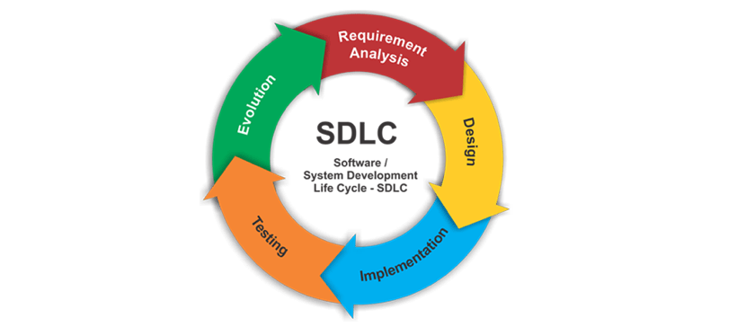
SDLC (Software Development Life Cycle)
Software development life cycle (SDLC) is a structured process that is used to design, develop, and test good-quality software.
SDLC, or software development life cycle, is a methodology that defines the entire procedure of software development step-by-step.
The goal of the SDLC life cycle model is to deliver high-quality, maintainable software that meets the user’s requirements.
SDLC in software engineering models outlines the plan for each stage so that each stage of the software development model can perform its task efficiently to deliver the software at a low cost within a given time frame that meets user’s requirements.

Slide 4
Sprints in Agile Project Management
A Sprint Is A Short, Time-boxed Period When A Scrum Team Works To Complete A Set Amount Of Work. Sprints Are At The Very Heart Of Scrum And Agile Methodologies, And Getting Sprints Right Will Help Your Agile Team Ship Better Software With Fewer Headaches.
Sprint In Agile Methodology Usually Has A Duration Of 1-4 Weeks.
In The Project, The Sprint Consists Of 8 Consecutive Cycles.

Slide 5
Project Explanation- Travel Booking System
This Project is about creating a User-friendly Ticket Booking platform for user to search, book and manage their travel arrangements which includes Flights, Hotels, Bus, Car rentals and many more integrated into a single software as well as Website.
The Project ensures that the Customer can easily search and browse for Tickets including Flights, Trains, Bus, Hotels, etc.

Slide 6
Sprint 1-2: Initialization of Project Planning and Preparation of Module
In this Sprint, the project roadmap and design plan is created
Requirements were gathered and an initial meeting regarding the project expectations were taken from the client.
The frontend developer creates rough design with coordinating with UX designer.
In Sprint 2, the Framework design begins for the software. Frontend developer creates an engaging User-friendly dashboard for booking and managing ticket bookings.
Frontend Developer creates Login API screen for faster access to the dashboard.
Preparing the necessary documentation for the BA for analysis.
Design User Authentication feature for the security of user logging in the software.

Slide 7
Sprint 3-4: Development Phase-II Begins
User needs the Search bar and filter category for searching flight, hotels and train tickets using price, category and duration.
Finalizing the API for better performance, Frontend and Backend developers integrate with each other for better quality product.
QA will check the software for quality issues if any and give feedback accordingly.
We will develop a database to store booking details of customers.
Frontend developer will design the interface to capture booking details (e.g., dates, destination, passenger info).

Slide 8
Sprint 5-6: Building Payment Gateway and User profile
For secure transactions of bookings, we will integrate the software with payment gateways like Razorpay, or Billdesk to ensure the authenticity of the payments made through the platform.
Backend team will manage the data processed in the booking and transaction process.
For managing ll the bookings, developers make an User profile section which includes all booking and transaction history in one place.
Also, it includes the feature to add, delete or cancel the bookings.

Slide 9
Sprint 7-8: Testing, Deployment, and User Feedback
The Final software is ready to deployed, before that there were final tests that need to be done by the Quality Analyst to ensure the software is error free.
After testing done by QA, necessary feedback were taken and fixed by the developers.
At last the Software is deployed into the market for feedback analysis.
After getting feedbacks, it is published into the app stores for public use.

